Slide 1
Quantum Number Notes
Each electron is defined by its own unique set of quantum numbers
Each electron in the atom has its own set of 4 numbers
Elements have all the electrons for the elements that come before it plus its last electron – the electron that defines the atom.

Slide 2
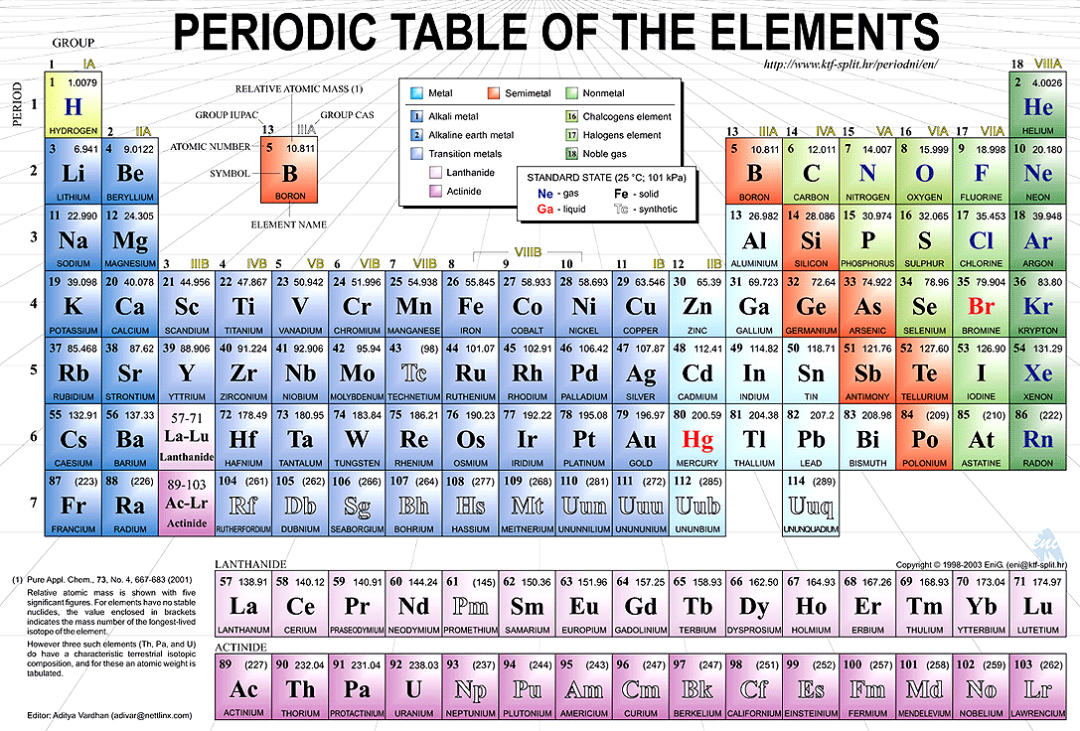
First Quantum number n
The principle quantum number n= the period number

Slide 3
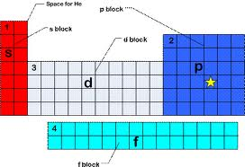
Row numbers change
Please note- in the d block and f block the principle quantum number is one lower than the row number

Slide 4
Second Quantum Number l l= n-1
The second quantum number l has values of n-1, this also equals the sublevels s,p,d and f
If n= 1 then the values of
l = 0 -- s block
l = 1 -- p block
l=2-- d block
l= 3 – f block

Slide 5
Third Quantum number ml
ml is the obital it is the range –l…0…+l
In the s block there is one orbital the 0 orbital
In the p block there are three orbitals -1, 0, +1
In the d block there are 5 orbitals -2, -1, 0, 1 , 2
In the f block there are 7 orbitals -3,-2, -1, 0,1, 2, 3

Slide 6
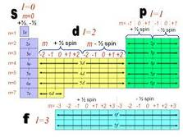
This table has the n,l,m numbered!

Slide 7
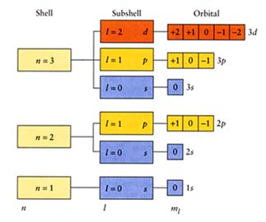

Slide 8
Spin
The fourth quantum number is spin the electrons can be spin can have values of +1/2 or -1/2. The +1/2 means that the electron is spinning clockwise the -1/2 means that the electron is spinning counter clockwise.
One electrons spinning clockwise will fill each orbital until all orbital's are filled, then the counter clockwise spin electrons will pair up with the clockwise spin electrons

Slide 9
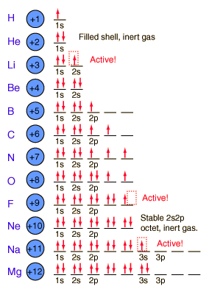

Slide 10
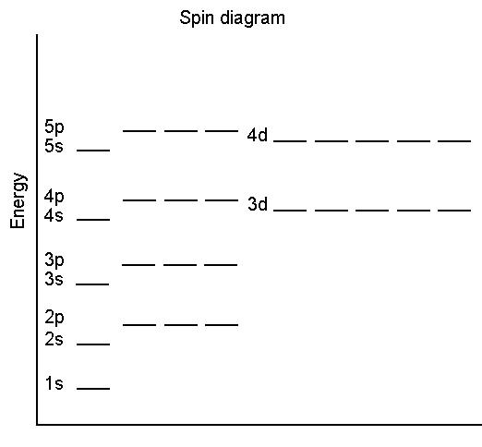
Energy Diagrams – Electrons fill from the lowest energy to the higher energy

